Slide 1
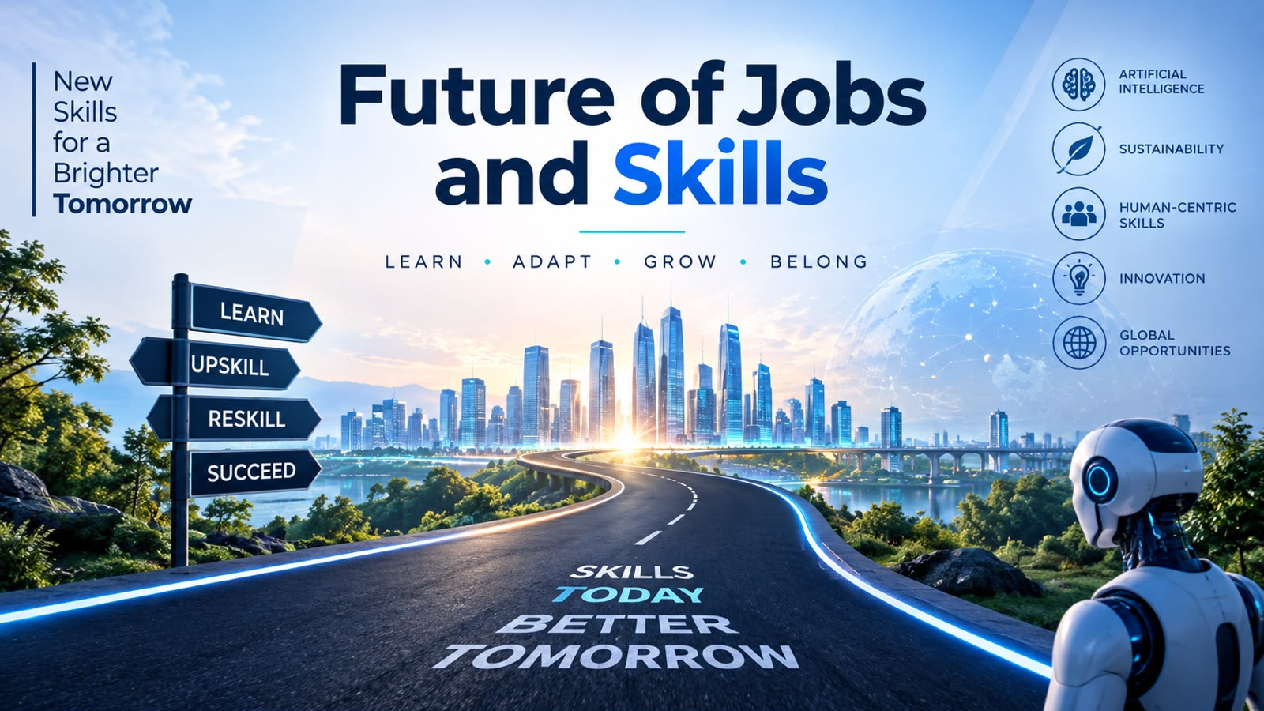

Future of Jobs
and Skills
NETAJI SUBHAS INSTITUTE OF TECHNOLOGY (NSIT), BIHTA
PRESENTED BY-
B.TECH- COMPUTER SCIENCE AND ENGINEERING
SECTION- B (1ST SEMESTER)
1.VAISHNAVI (116)
2.ARTI (81)
3.NEHA (107)
4.KHUSHBOO (106)
Notes:
WELCOMING EVERYONE. GOOD MORNING EVERYONE.PRESENTING OUR TOPIC.

Slide 2
01
Technology is changing the way we work.
WHY IT MATTERS
Why the Future of Jobs Matters
AI, automation, and digital tools are creating new job opportunities.
02
03
Some traditional jobs are changing or disappearing.
04
Workers need to continuously learn new skills.
Notes:
FOUSING PRESENTAION ON HW TECHNOLOGY,CHANGING JOBS AND SKILLS REQUIRED IN FUTURE. CREATING NEW OPPORTUNITIES BUT TRADITIONAL JOBS MAY DISAPPEAR. FOR STAYING RELEVANT LEARNING AND DEVELOPING SKILLS ARE MANDATORY .

Slide 3
What is the Future of Jobs and Skills?
FUTURE OF JOBS
How employment is expected to change due to technology, society, and the economy.
FUTURE SKILLS
Knowledge and abilities needed to succeed in emerging workplaces.
Key areas include:
Artificial Intelligence
Digital literacy
Critical thinking
Creativity
Communication
Notes:
WHAT IS FUTURE JOBS AND SKILLS. SKILLS REQUIRE AI,DIGITAL LIETRACY, CRITICAL THINKING ETC

Slide 4





Major Changes in the Workplace
🤖 AI & Automation
💻 Digital Transformation
🌍 Remote & Hybrid Work
Machines handle repetitive tasks.
More jobs require technology skills.
Flexible working is becoming common.
🔄 Reskilling & Upskilling
🧠 Human + AI Collaboration
Employees need continuous learning.
People increasingly work alongside intelligent tools.
Notes:
AUTOMATION AND AI CAN HANDLE REPITITIVE TASKS . DIGITAL TRANSFORMATION .. HYBRID WORK IS BECOMING VERY COMMON.

Slide 5
How Technology Changes Jobs
TECHNOLOGY ↓
AI & Automation ↓
Jobs & Tasks Change
New Jobs Created
Existing Jobs Evolve
NEW SKILLS ↓
Continuous Learning ↓
Future Workforce
Key idea: Technology does not simply remove jobs—it also changes existing roles and creates new opportunities.
Notes:
AI CHANGES THE NATURE OF JOBS. JOBS WILL EVOLVE . CONTINUOUS LEARNING IS VERY IMPORTANT.

Slide 6
Future Jobs & Skills in Real Life
Emerging Job | Important Skills
AI / ML Engineer | AI, programming, data
Cybersecurity Analyst | Security, networking
Data Scientist | Statistics, Python, analytics
Renewable Energy Engineer | Engineering, sustainability
UX/UI Designer | Design, creativity, user research
Digital Marketing Specialist | Marketing, analytics, communication

Slide 7
Impact of Future Jobs
LIMITATIONS
ADVANTAGES
Limitations
Advantages
Some repetitive jobs may be automated.
Skill gaps may increase.
Workers may need frequent retraining.
Access to technology and education may be unequal.
Creates new career opportunities.
Increases productivity and innovation.
Enables flexible and remote work.
Encourages continuous learning.

Slide 8
What Did We Learn?
01
The world of work is changing rapidly.
02
Technology will transform many existing jobs.
03
Human skills such as creativity, communication, adaptability, and critical thinking remain important.
04
Continuous learning is the key to staying future-ready.
05
The future is likely to be Human Skills + Technology Skills.
Notes:
WHAT DID WE LEARN ;THE FUTURE IS NOT HUMANS VS TECHNOLOGY ; IT IS HUMANS WORKING WITH TECHNOLOGY .

Slide 9
01
World Economic Forum – Future of Jobs Report
02
International Labour Organization (ILO) – Future of Work resources
References
03
OECD – Future of Work and Skills
04
Microsoft – Work Trend Index
05
IBM – Artificial Intelligence and Workforce resources

Slide 10
FUTURE OF JOBS AND SKILLS
Thank You!
Any Questions?
Under the Guidance of:
Ms. Aastha Kashyap
Assistant Professor, Department of CSE

